Slide 1





NATIONAL INTERNSHIP PORTAL
AI-Powered Internship Recommendation System
A Project Submitted in Partial Fulfillment of the Requirements for the Award of Degree of
Bachelor of Technology
Computer Science & Engineering
Submitted By:
Asit Kumar (2200350100018)
Dheeraj Kumar (2200350100023)
Tushar Sharma (2200350100068)
Project Guide:
Dr. Shwetav Sharad
Babu Banarasi Das Institute of Technology (BBDIT)
Ghaziabad, Uttar Pradesh
Dr. A.P.J. Abdul Kalam Technical University, Lucknow
2026

Slide 2
The Problem Statement
Traditional portals lack personalization and intelligent matching, creating a disconnect in the ecosystem.
school
For Students
work_outline
For Recruiters
settings_suggest
System Limitations
Key Pain Points
No personalized recommendations
Apply to irrelevant internships
Time-consuming manual search
Operational Hurdles
Too many irrelevant applications
Difficult candidate filtering
Inefficient hiring process
Technical Gaps
No AI-based matching
Static job listings
No resume-based analysis
Critical Challenge
Significant mismatch between student skills and internship requirements leads to lost opportunities for both parties.
error_outline
National Internship Portal – AI-Powered Recommendation System | 2026

Slide 3
Our Solution
An AI-powered platform providing personalized recommendations based on student skills.
psychology
Main Features
bolt
Key Highlights
check_circle
Problem Solved
AI-based resume analysis
Personalized recommendations
NLP skill extraction
Application tracking system
Role-based access control
Smart Matching: Skill-based
AI Engine: TF-IDF & Cosine
Automation: Zero manual entry
Efficiency: Faster recruitment
Reduces irrelevant applications
Saves time for all stakeholders
Improves hiring accuracy
Data-driven decision system
auto_awesome
The Result: A seamless bridge between student potential and industry requirements using Advanced Machine Learning.
National Internship Portal – AI-Powered Recommendation System | 2026

Slide 4


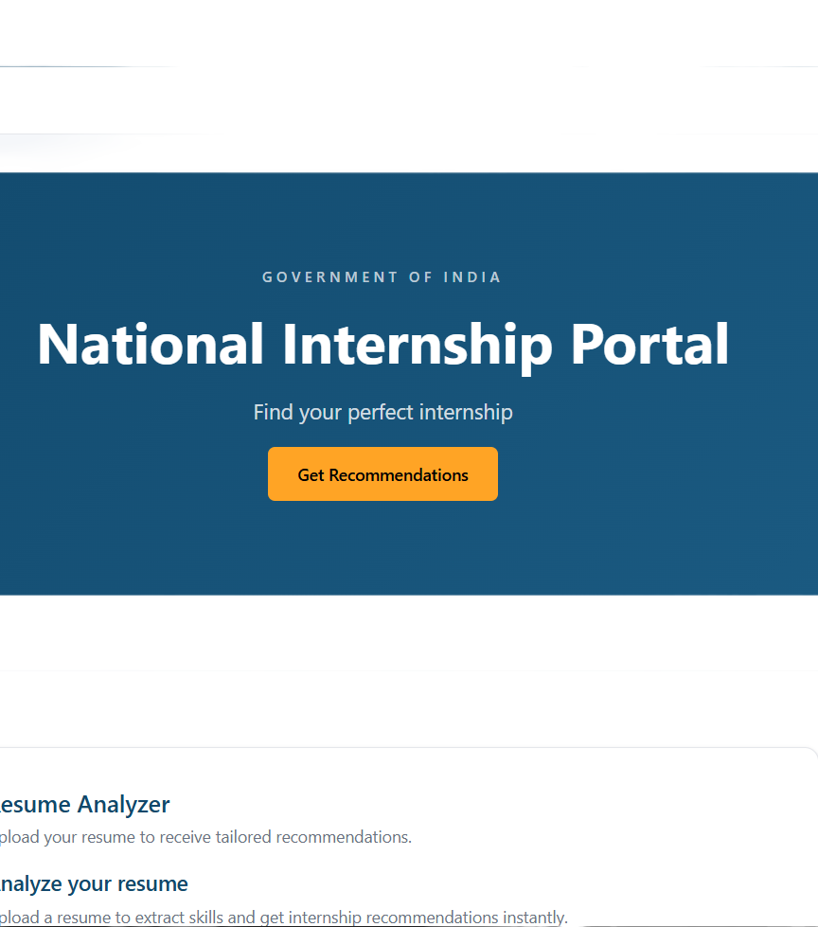

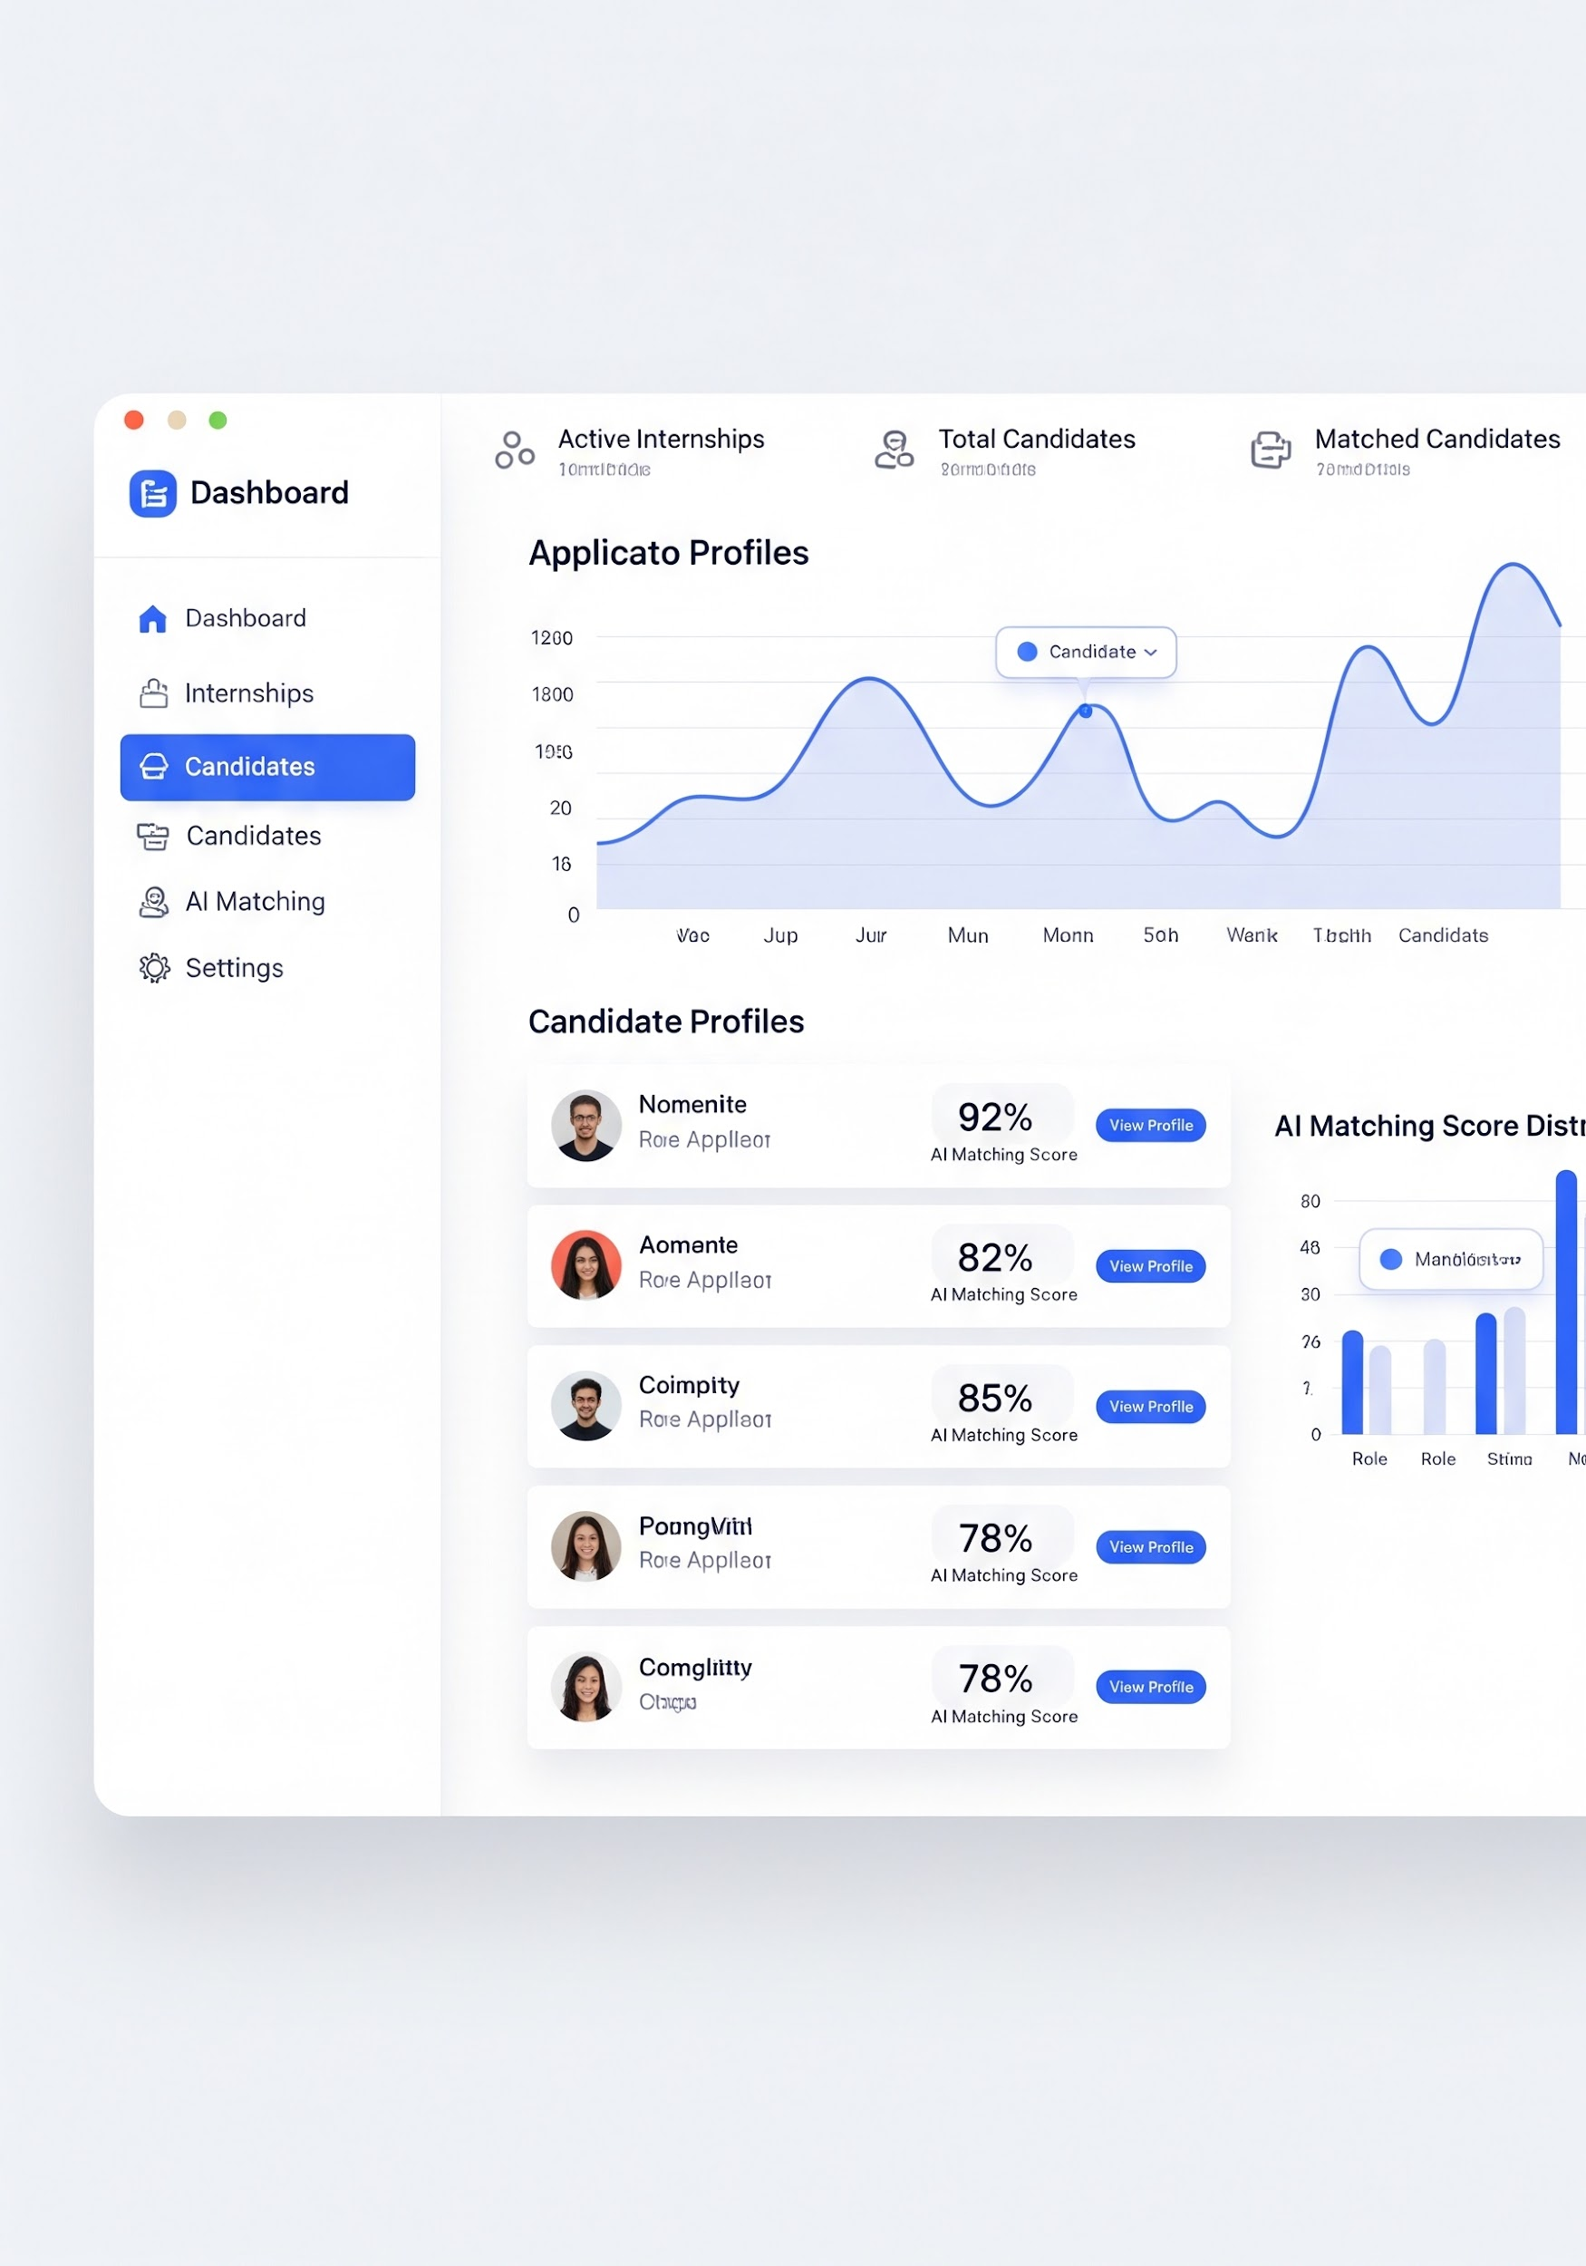
Key System Features
Core capabilities of the AI-Powered Recommendation platform
psychology
AI Resume Analysis
auto_awesome
Smart Matching
Extracts skills automatically using advanced NLP for parsing.
Matches student skills with internships via ML algorithms.
bar_chart
Application Tracking
security
Secure RBAC
Real-time status updates and structured hiring workflow.
Specific Student, Company, and Admin secure access roles.
UI
National Internship Portal – AI-Powered Recommendation System | 2026

Slide 5


Technology Stack
Technologies powering the platform
Presentation Layer
Application Layer
Data Layer
devices
Next.js
React-based framework for high-performance frontend.
Tailwind CSS
TanStack Query
settings_input_component
FastAPI
High-performance Python backend logic.
Pydantic
JWT Authentication
storage
PostgreSQL
Robust relational database for system data.
SQLAlchemy ORM
psychology
AI Components: Scikit-learn | TF-IDF + Cosine Similarity | Natural Language Processing (NLP)
National Internship Portal – AI-Powered Recommendation System | 2026

Slide 6
System Architecture
Presentation Layer
User Interaction
User Interface (Next.js)
Student Dashboard | Company Dashboard | Admin Panel
devices
Application Layer (Backend Logic)
🤖 AI Engine
settings_input_component
FastAPI Framework
Authentication (JWT)
Resume Parsing (NLP)
Business Logic
Recommendation Engine (ML)
• TF-IDF Vectorizer
• Cosine Similarity
• NLP Processing
Data Layer
storage
PostgreSQL
User Data, Internship Data, Applications
National Internship Portal – AI-Powered Recommendation System | 2026

Slide 7



AI Recommendation Engine
⚙️ ML Processing
Input Data
📊 Similarity Analysis
1. TF-IDF Vectorization
Converts raw text into a frequency-importance weighted matrix.
2. Feature Extraction
Identifies relevant NLP tokens (Python, React, NLP).
3. Vector Space Modeling
[0.12, 0.0, 0.85, 0.44...]
📄 Student Resume
Skills, Experience, Projects
📑 Job Description
Requirements, Tech Stack
Similarity Score
0.92 Match
🎯 Ranked Rec.
Advanced matching logic calculates the angular distance between skill vectors to ensure high-precision internship placement.
National Internship Portal – AI-Powered Recommendation System | 2026

Slide 8


NLP-Based Resume Parsing
National Internship Portal – AI-Powered Internship Recommendation System
1. Input Data
2. Extraction
3. NLP Engine
4. Skills
5. Structured
upload_file
settings
psychology
label
bar_chart
Resume Upload
PDF / DOCX format
Raw Text
PyPDF2 / PDFMiner
Tokenization
Stop-word Removal
Identification
Tech Stack Extraction
Data Storage
For Recommendations
JSON OUTPUT EXAMPLE
{ "name": "John Doe", "skills": ["Python", "React", "NLP", "FastAPI"], "experience": "3 Years", "education": "B.Tech CS" }
Automated pipeline extracts professional attributes from raw documents using industry-standard NLP techniques.
National Internship Portal – AI-Powered Recommendation System | 2026

Slide 9
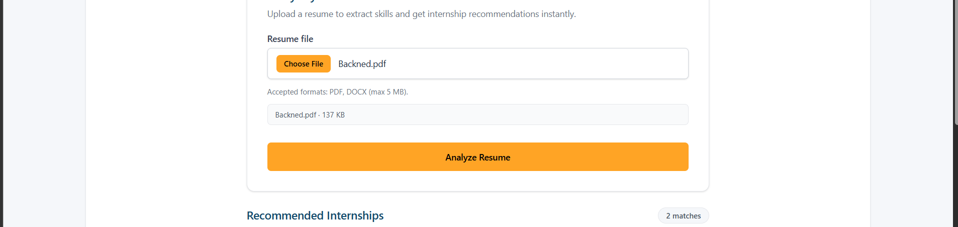
System Workflow
1
2
3
4
5
6
7
person
description
smart_toy
storage
settings
bar_chart
push_pin
User Action
Login / Register
Input
Resume Upload
Processing
NLP Skill Extraction
Data Storage
Database Entry
AI Engine
Similarity Scoring
Output
Ranked Recs
App Flow
Apply & Review
National Internship Portal – AI-Powered Recommendation System | 2026

Slide 10


Security & Privacy
Ensuring safe and secure user data
JWT Authentication
Secure login system
TOKEN-BASED
Role-Based Access
Controlled permissions
RBAC SYSTEM
vpn_key
admin_panel_settings
Password Protection
Encrypted using bcrypt
ENCRYPTION
Secure Actions
Protected operations
CONFIRMATION
lock
gpp_maybe
Global Data Protection Standards
Our AI-powered portal implements multi-layered security protocols to safeguard student and recruiter information at every touchpoint.
National Internship Portal – AI-Powered Recommendation System | 2026

Slide 11
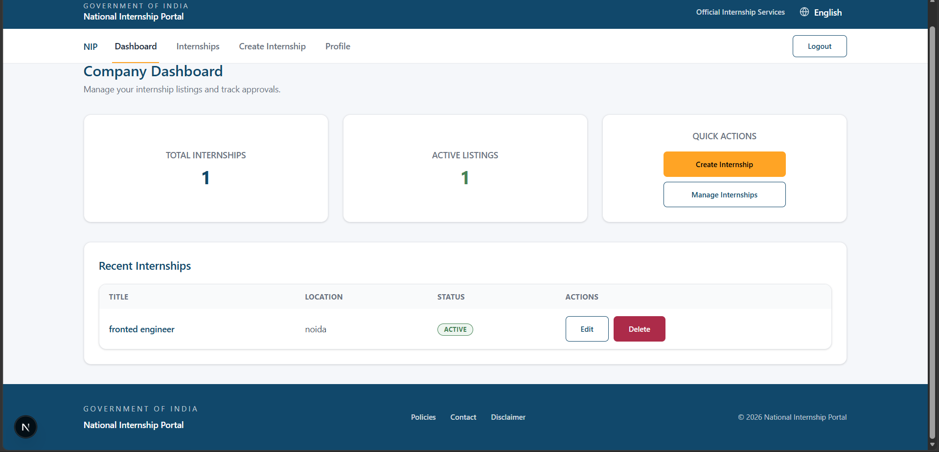
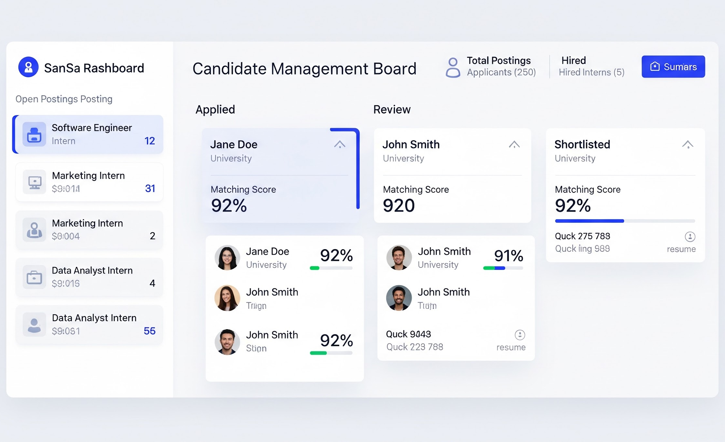


Company & Recruiter Dashboard
Insert Company Dashboard UI Screenshot
business_center
Internship Management
Create, edit, and track postings.
groups
Applicant Tracking
Centralized resume & profile access.
account_tree
Application Pipeline
Review → Shortlisted → Selected.
auto_awesome
Smart Filtering
Rank by AI match score & technical skills.
AI helps recruiters identify the most relevant candidates quickly based on similarity scoring
National Internship Portal – AI-Powered Recommendation System | 2026

Slide 12

Agile Development Methodology
Iterative Lifecycle: National Internship Portal
assignment
code
science
sync
rocket_launch
01 Planning
Req. Gathering
System Design
02 Development
Backend APIs
Frontend UI
03 Testing
Unit & System
Validation
04 Feedback
Bug Fixing
Improvements
05 Deployment
Final Launch
Site Release
Sprint 1
Sprint 2
Sprint 3
Sprint 4
Sprint 5
Auth & Database Structure
Student Module & Resume Parsing
Company Portal & Dashboards
AI Recommendation Engine
UI Polish, Security & QA
National Internship Portal – AI-Powered Recommendation System | 2026

Slide 13
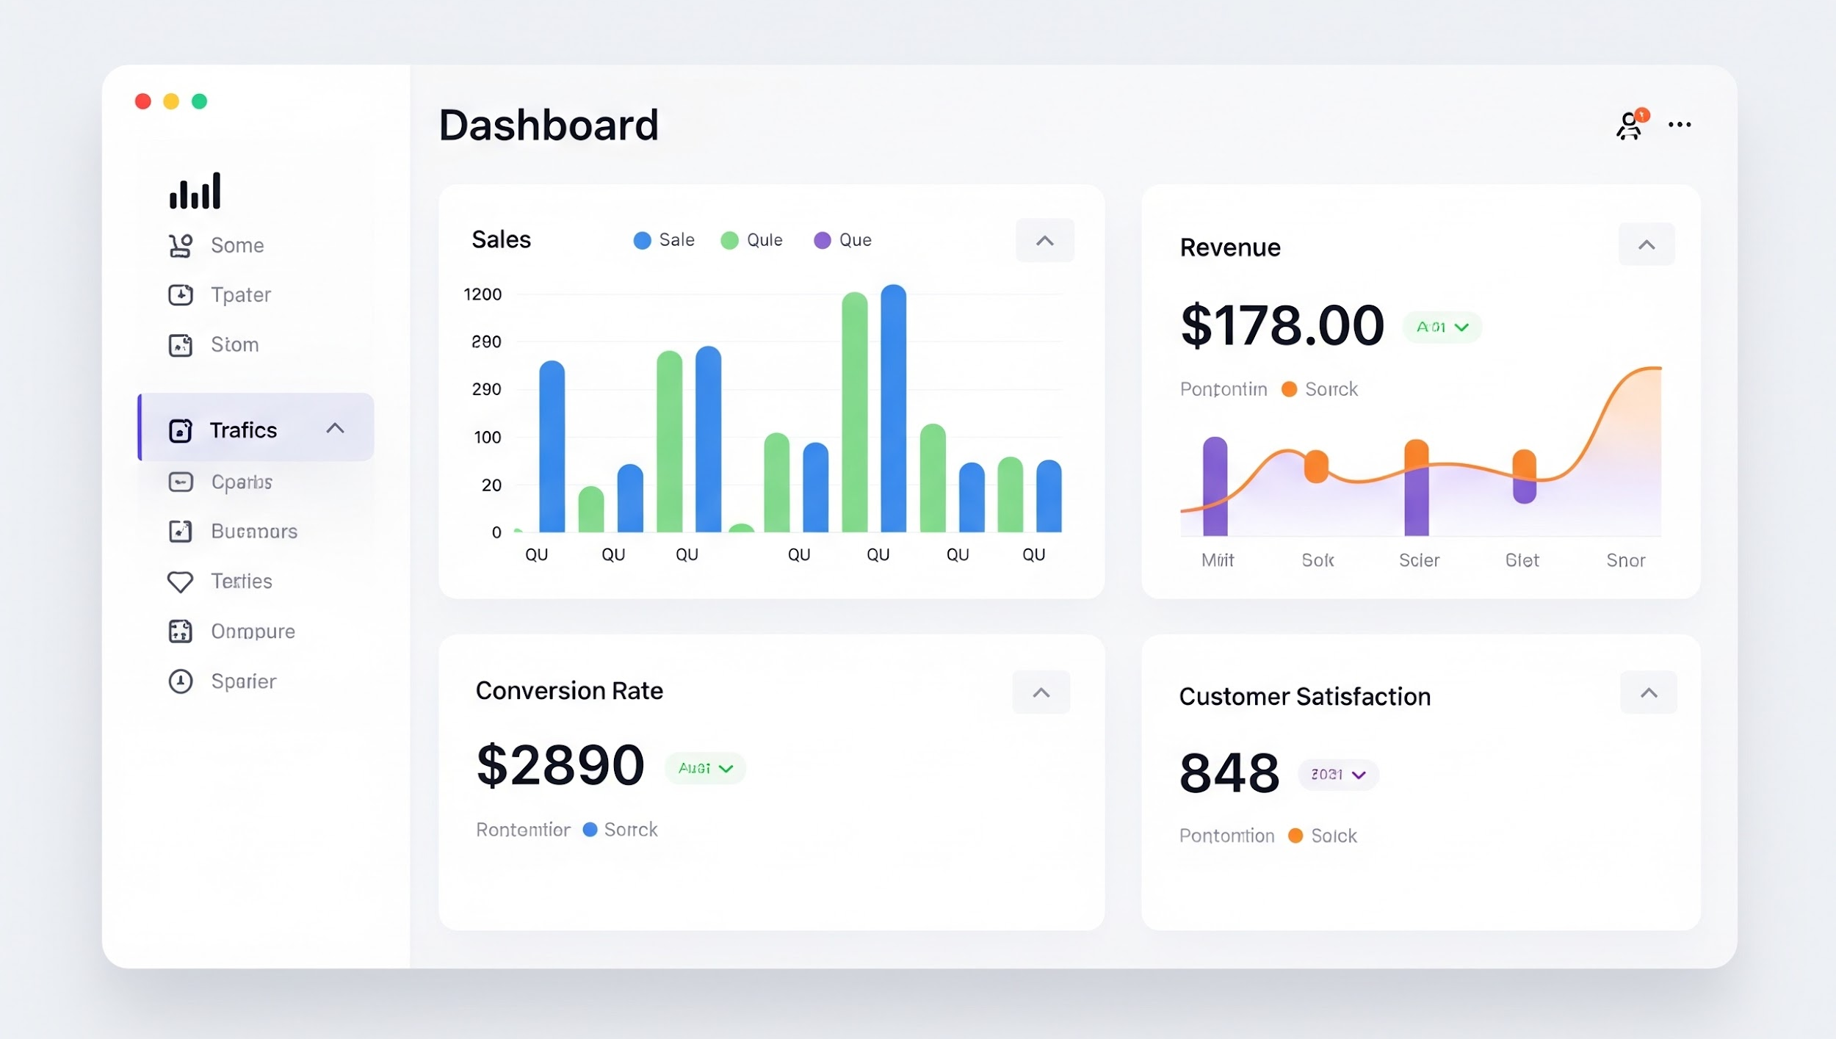
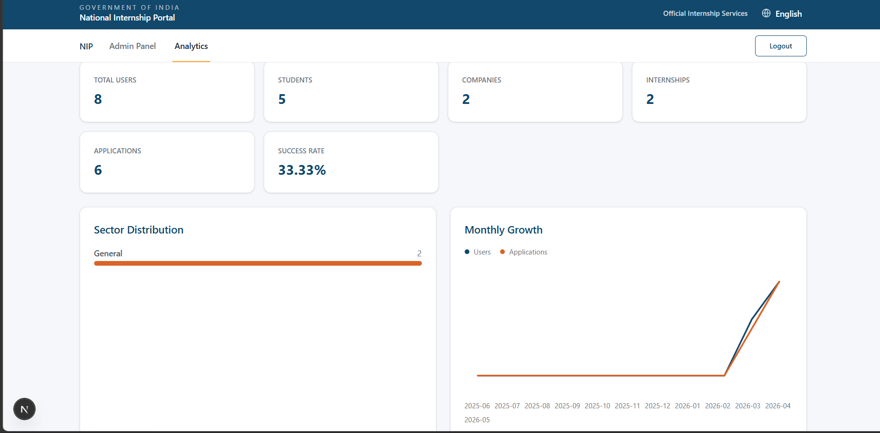
Testing & Results
System performance and validation
Unit Testing
APIs tested individually Modules validated
Recommendation Accuracy
96.4%
✔️ High Precision Match
API Response Time
< 280ms
⚡ Ultra-Fast Processing
science
Integration Testing
Frontend + Backend tested API communication verified
link
Validation Checks
✔️ Secure Authentication
✔️ Database Persistence
✔️ NLP Resume Parsing
✔️ Role Access Control
System Testing
End-to-end workflow tested Full system validation
settings
Result Analytics View
auto_awesome
System matches students with internships based on skills, improving accuracy and reducing irrelevant applications by 70%+.
National Internship Portal – AI-Powered Recommendation System | 2026

Slide 14


Future Scope
Enhancing the platform with advanced features
rocket_launch
smart_toy
code
Career Vision
Complete Career Platform
Advanced AI
LLMs & BERT Integration
Coding Tests
In-platform Evaluation
event_available
phonelink_setup
Interview Booking
Calendar API Automation
Mobile App
React Native Solution
National Internship Portal – AI-Powered Recommendation System | 2026

Slide 15

Conclusion & Q&A
• AI-powered system for smart internship matching
• Improves hiring accuracy and reduces effort
• Bridges gap between students and companies
A smarter, faster, and more efficient recruitment solution.
rocket_launch
Questions?
National Internship Portal – AI-Powered Recommendation System | 2026

Slide 16



Thank You!
Transforming internships with intelligence.
rocket_launch
Questions?
National Internship Portal – AI-Powered Recommendation System
Asit Kumar & Project Team | 2026

